Slide 1
Week 2 SIA Seminar Session plan
First half
Lecture recap
Activity 1 (Card game)
Activity 2 (Bring me news)
Second half
Worksheet
Worksheet – check your answers
Summary and Q&A

Slide 2
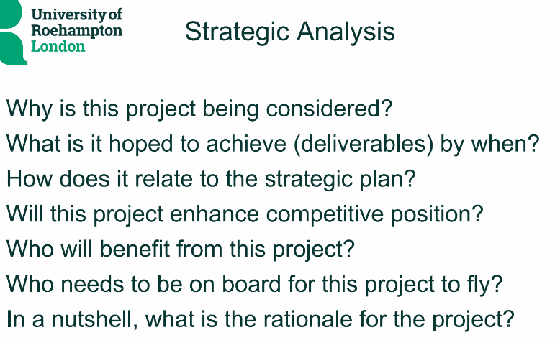
Lecture recap Week 2: Investment appraisal processes

Slide 3
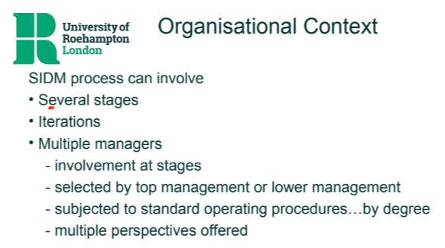
Lecture recap Week 2: Investment appraisal processes

Slide 4

Seminar Activity – Card game 1.2
Card game: It is the way to randomise some different case examples to discuss. Throughout the module, we call it card game.
The card will show the name of a well-known project (google it if it is unfamiliar)
Answer the following questions:
What organisation is responsible for it?
What is the business model (how do they create value for whom) of that organisation?
Who would be the key stakeholders in the project & what would they expect from it?
Where might the funding come from for it?

Slide 5


Card game 1.2 - From seminar 1 (share your answers here) Card = 5 of diamonds Scenario = Tesla Model 3 (new product - electric car)
5
5

Slide 6

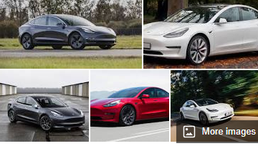
What organisation is responsible for it?
What is the business model (how do they create value for whom) of that organisation?
Who would be the key stakeholders in the project & what would they expect from it?
Where might the funding come from for it?
1.2 Tesla Model 3
Tesla Inc, a US electric vehicle(EV), battery energy storage and solar panel company
By making an affordable fully EV compared to the previous model
Battery maker: Panasonic (Profit), international policy makers e,g, United Nations Climate Change Conference (COP26) (proceed green agenda) etc..
Research and Development (R&D) budget
Working Capital
Notes:
A successful NPD: The Model 3 has been the world's top selling plug-in electric car (PEV) for three years running, from 2018 to 2021. It was overtaken by Model Y in 2022
Car is just a manifestation. Tesla’s Distributed energy business by offering EV and own charging station network.
Stakeholders:
Supplier relationships and how battery-related revenue is doing can be a key driver for Tesla.
Research and development (R&D) costs are the costs you incur for activities intended to develop or improve a product or service. They are listed on the income statement under Operating Expenses.

Slide 7

Card game 2.2 - Attempt this on your own after seminar 2 (to share your answers next week in seminar 3) Card = 7 of hearts Scenario = Walt Disney takeover of 21st Century Fox
7
7

Slide 8
How would this project have been identified?
What procedure might be used to develop it and what information would you need?
What criteria and/or process might be used to appraise this at the proposal stage?
2.2 Walt Disney
Card game 2.2 - Attempt this on your own after seminar 2 (to share your answers next week in seminar 3)

Slide 9

Seminar activity –Bring me news!
Bring me news model: A way to practice decision-making context analysis. You can read and find any managerial decisions in the latest news and reflect them to apply to your assignment.
Pre-seminar:
What firm/organisation has been in the business news this week &why?
During the seminar:
What type of project does the news relate to?
In/after the seminar:
How can I learn from this to enhance my knowledge of SIA and/or for ass’t?

Slide 10
Decision-making context
SIA context
Business Model
Business ownership/ history
Market/ trading conditions
Industry norms/ benchmarks
1. What does the organisation do to create value?
5. How does this shape the decision context?
2. Who owns the enterprise & how has it developed?
4. What are the current industry expectations?
3. What is the business environment/ competitive situation?

Slide 11
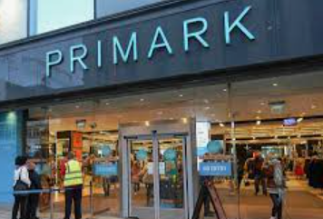
Practice context analysis - e.g. 1 Primark (High street fast fashion store)
5. Risks of shrinking in-store market if not online, Risk of fierce competition in online market
SIA context
Business Model
Business ownership/ history
Market/ trading conditions
Industry norms/ benchmarks
1. What does the organisation do to create value?
1.Buys commodity from manufacturers to sell in shops (need to hold inventory & own/rent premises)
5. How does this shape the decision context?
2. Started business in 1969, subsidiary of Associated British Foods (ABF) (low margins so need to maintain high turnover)
2. Who owns the enterprise & how has it developed?
4.Decisions to invest in online trading platform?
4. What are the current industry expectations?
3.Decline in footfall on high street as online sales grow, an escalation in the cost of energy and logistics
3. What is the business environment/ competitive situation?

Slide 12
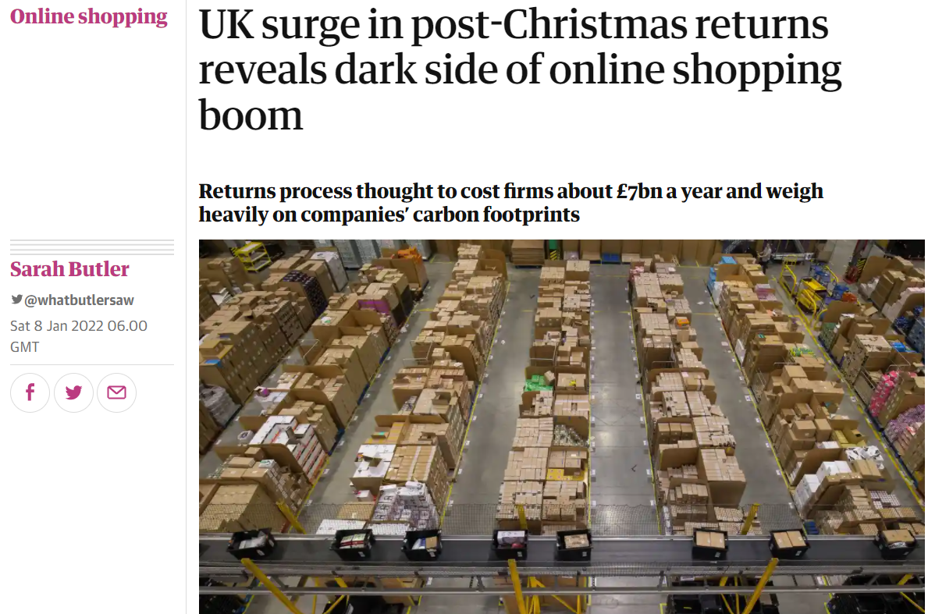
What are the likely risks attached to investing in online trading platform? (what if? scenarios)?

Slide 13


Any questions? (on activities or the assessment brief)

Slide 14
Impact of context on SIA
What assets might the enterprise need (to invest capital in) to create value (business model)?
What sort of margins & volumes are expected (in view of trading conditions/environment)?
What management information would be needed to make SIDs in this context?
What are the likely risks attached to investing in this activity (what if? scenarios)?

